Slide 1
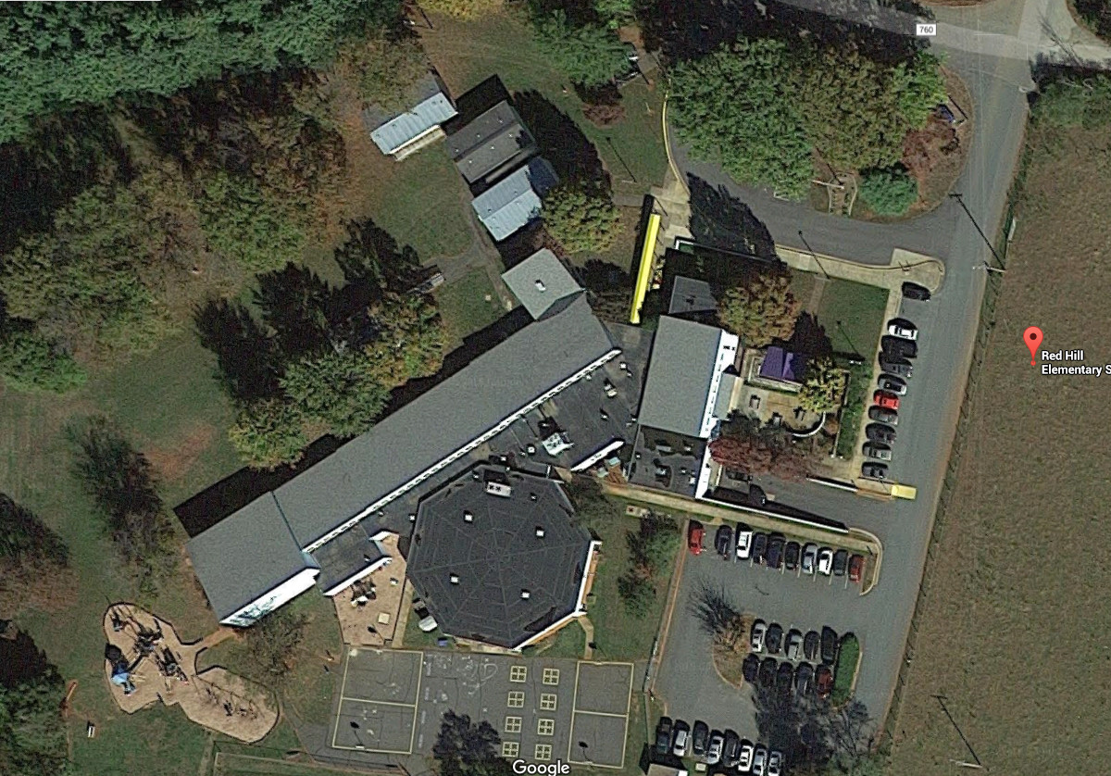

Red Hill Elementary School
Addition and Renovations
December 10, 2015

Slide 2
Project Scope
Modernization: Modernize and newly furnish the Media Center and 13 classrooms.
Security Upgrades:
Construct a new front office suite addition including a Security Vestibule, Waiting area, Principal’s office and Clinic. The existing Admin Office will be renovated and re-purposed.
Construction Budget: $ 1,377,800.
Furniture Budget: $ 273,000.
RED HILL ELEMENTARY SCHOOL ADDITION & RENOVATIONS

Slide 3
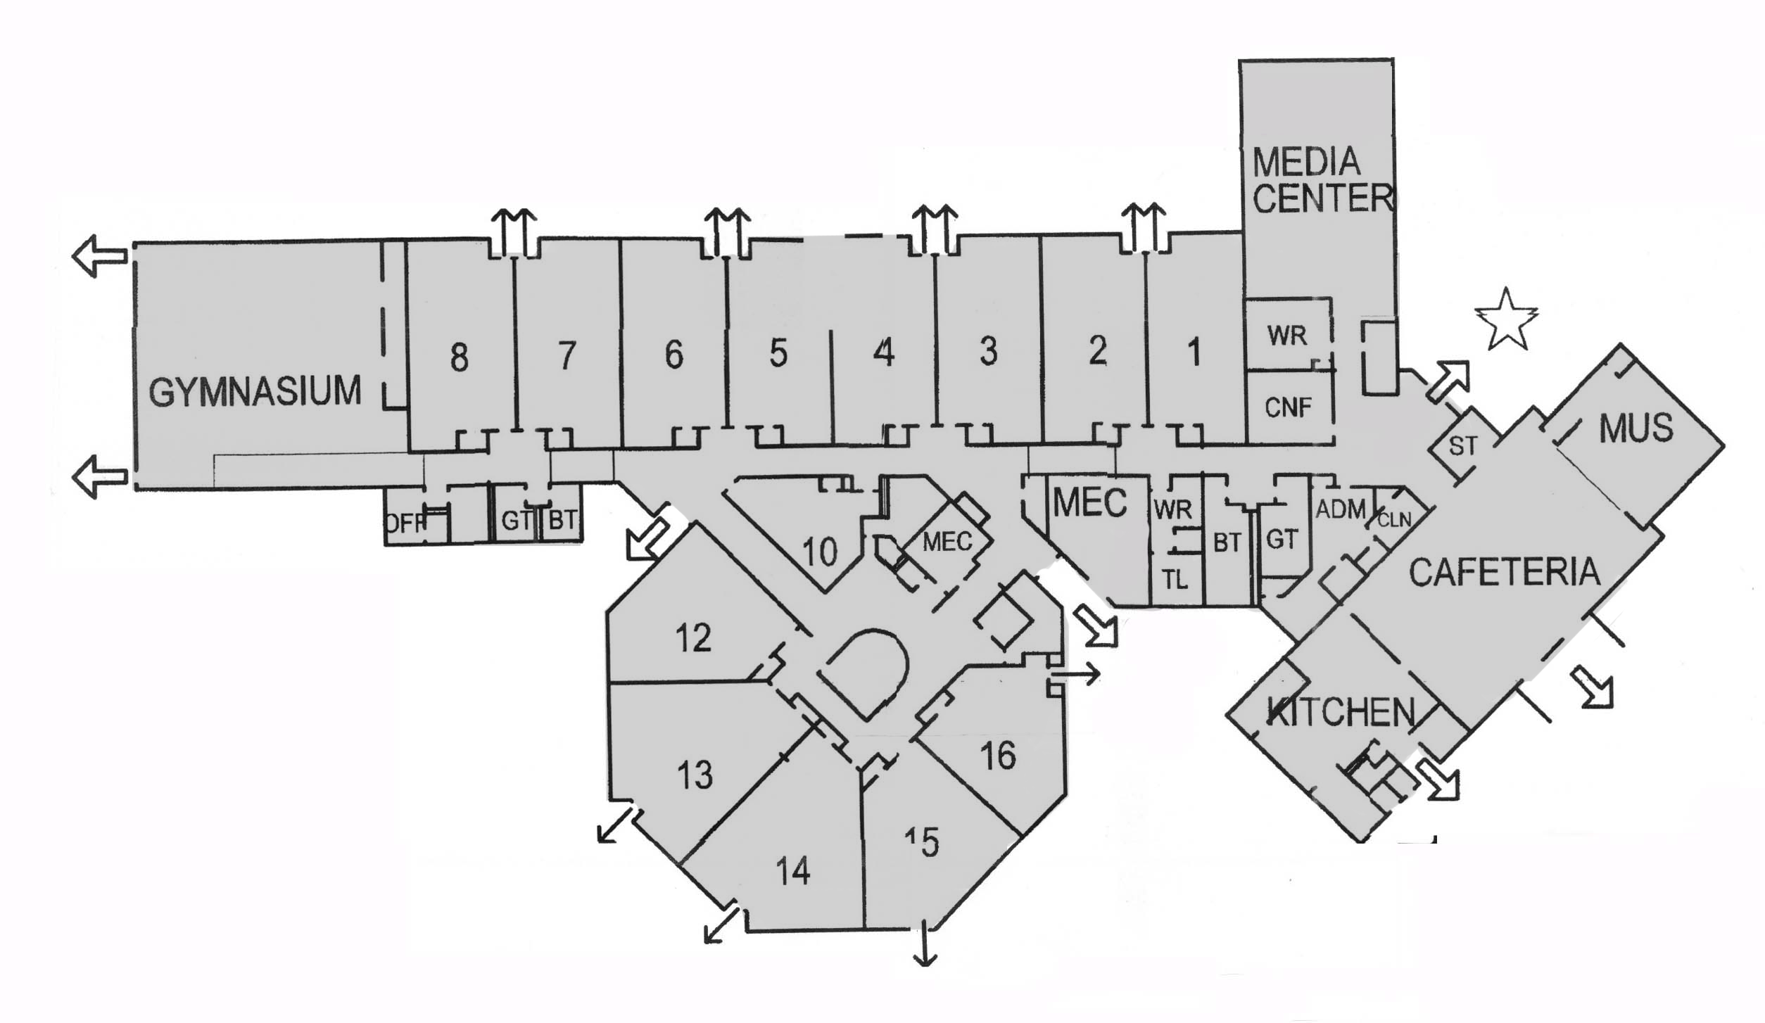
Existing Plan
RED HILL ELEMENTARY SCHOOL ADDITION & RENOVATIONS

Slide 4
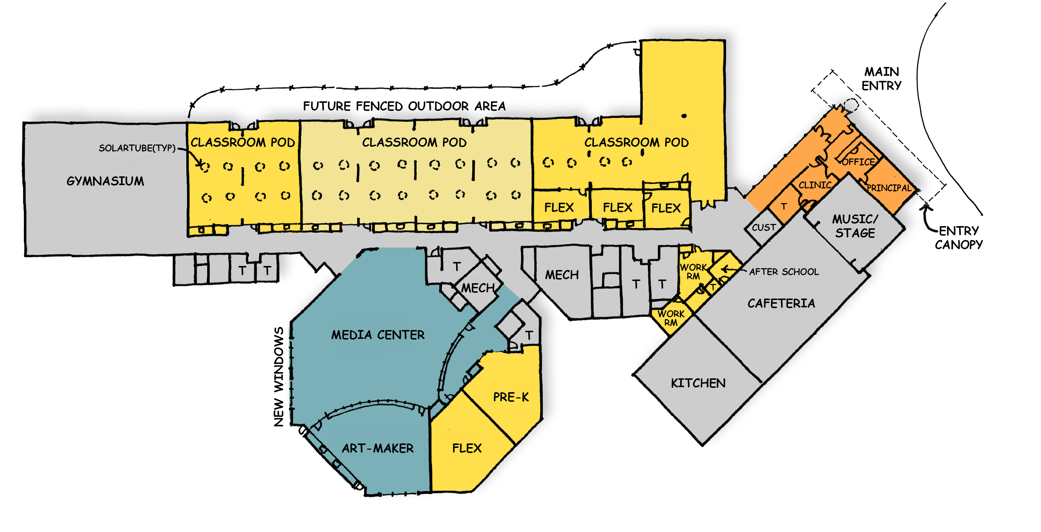
Proposed Plan
RED HILL ELEMENTARY SCHOOL ADDITION & RENOVATIONS

Slide 5
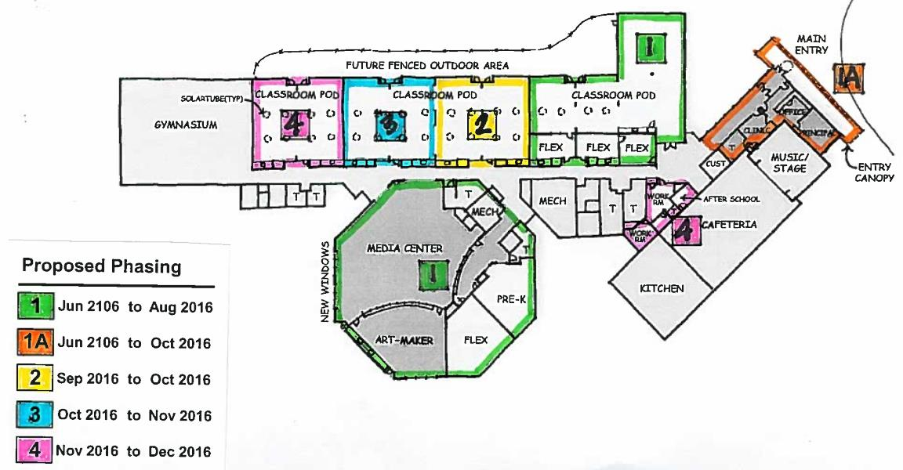
Proposed Phasing
RED HILL ELEMENTARY SCHOOL ADDITION & RENOVATIONS

Slide 6
Next Steps
Planning and Design:
Continue the development of the plans for the project.
Co-ordinate with an HVAC Replacement project also scheduled for the Summer of 2016.
Furniture:
Develop furniture selections, in conjunction with recently purchased furniture.
RED HILL ELEMENTARY SCHOOL ADDITION & RENOVATIONS

